Slide 1

2025 BA-Eindwerkstuk Seminar
Class #3: Conducting a Literature Review
Workgroup 103
Dr. Steven Denney
Friday, 21 February 2025

Slide 2
The question, problem & analysis
What is your question?
What is your problem?
What are your sources, and how will you analyze them?

Slide 3
Roadmap
Types of Literature Reviews
Reflect
Best Practices
Example
Exercise

Slide 4
Purpose of a Literature Review
Situates your research (question) in context: Shows how your study extends, refines, or challenges existing work.
Identifies gaps in knowledge: Reveals contradictions, unresolved questions, or overlooked areas in prior studies.
Motivates empirical strategies: Shows what methods and empirical strategies are available and (sometimes) why these should be adjusted.
Establishes researcher credibility and relevance: Demonstrates you’ve built upon a recognized foundation of scholarship.

Slide 5
Types of Literature Reviews

Slide 6
Argumentative Review
Purpose: Critically examine a body of literature to support or refute an existing argument or assumption.
Approach: Selectively include sources to develop a stance or “contrarian” viewpoint.
Watch out for: Potential bias—argumentative reviews can overemphasize sources that favor one side.

Slide 7
Integrative Review
Purpose: Summarize and synthesize past research to generate new perspectives.
Approach: Include all relevant studies addressing the same research question or hypothesis.
Key value: Creates or refines frameworks and theories.
Most common type in the social sciences.

Slide 8
Historical Review
Purpose: Trace the chronological development of a theory, concept, or issue.
Approach: Identify how a topic or scholarly conversation evolved through time.
Key value: Provides historical context and identifies trends or turning points to inform future research.

Slide 9
Methodological Review
Purpose: Focus on research methods rather than findings.
Approach: Compare how studies collect and analyze data, exposing strengths, weaknesses, or patterns.
Key value: Highlights new approaches, ethical considerations, and overlooked techniques in the field.

Slide 10
Systematic Review
Purpose: Provide a comprehensive and unbiased summary of all available evidence on a focused research question.
Approach: Follows predetermined, transparent criteria to search, evaluate, and synthesize existing research.
Typical in: Clinical and health-related fields, but increasingly adopted in the social sciences.

Slide 11
Theoretical Review
Purpose: Examine how theory or theories have evolved to explain a phenomenon.
Approach: Explore existing conceptual frameworks; identify gaps or inconsistencies; propose new hypotheses.
Key value: Helps establish the theoretical basis for your own study and points to directions for further research.

Slide 12
Reflect

Slide 13
Types of Literature Reviews (recap)
Argumentative Review: Support or refute an existing argument; watch for bias.
Integrative Review: Summarize and synthesize past research to propose new perspectives.
Historical Review: Trace the evolution of theories or topics over time.
Methodological Review: Focus on methods and approaches used, not just findings.
Systematic Review: Formal, exhaustive search with strict criteria; common in clinical/social sciences.
Theoretical Review: Examine how theories emerge and interrelate in your field.
You will mix and match depending on your question, sources, and methods

Slide 14
What about you?
What is your “literature”?
What kind of sources will you read?
What kind of review(s) will you do?

Slide 15
Best Practices

Slide 16
Preparation
Clarify your research question: Understand your main goal and how it fits existing studies.
Conduct targeted searches: Use library databases, journal indexes, citation tracking, and curated bibliographies. Make good use of bibliographies of representative studies!
Collect and organize sources: Gather essential studies (the “must-reads”) and categorize them thematically or chronologically. Work back from these.

Slide 17
Organization
Chronological Structure: Good if developments clearly follow a timeline, but not always necessary.
Thematic (Conceptual) Structure: Group studies by themes, subtopics, or shared concepts.
Methodological Structure: Compare/contrast research designs, samples, and data analysis techniques.
Combination Approach: Often, reviews combine two or more structures (e.g., chronological then thematic).

Slide 18
Reading
Summarize and evaluate: Go beyond summarizing results; critique scope, evidence, and limitations.
Keep an annotated bibliography: Include short, critical summaries and keywords for each source.
Track conceptual links: Visual connections using digital or physical tools (tables, mind maps).
Manage references: Use citation software (Zotero, Mendeley, EndNote) for organization.

Slide 19
Writing Tips
Integrate primary and secondary sources: Bring in direct evidence where relevant, but maintain focus on analyzing prior work.
Look for patterns or consensus: Determine convergences among studies, noting the main points of agreement.
Note conflicting perspectives: Highlight where scholars disagree; show why it matters to your project.
Revisit and refine: Reevaluate your sources and add new references as your own study evolves.

Slide 20
Example

Slide 21
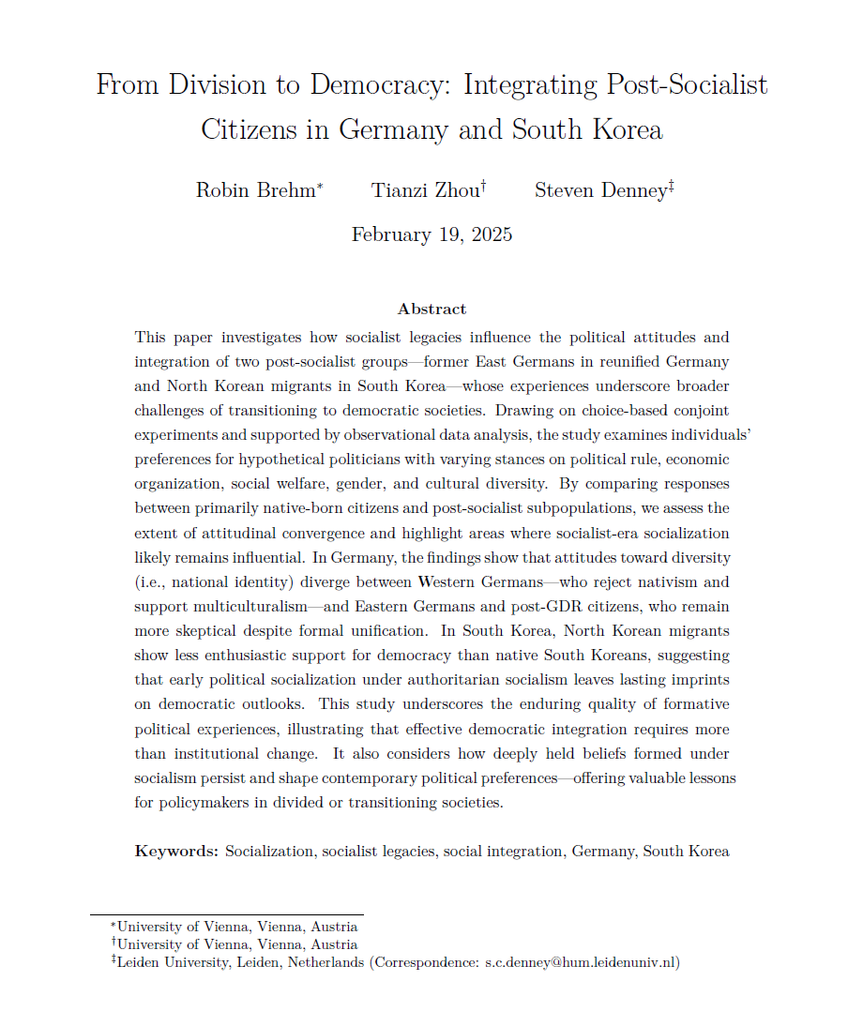

Slide 22
From Division to Democracy I
Question: How do socialist legacies shape the political attitudes and integration of individuals transitioning from socialist systems to democratic contexts?
Problem: Despite formal unification (in Germany) or unification in process (South Korea), political and social attitudes formed under socialism may endure under democratic rule and create social discordance. Previous studies suggest this, but they use a limited range of questions presented in overly simplistic ways.

Slide 23
From Division to Democracy II
Type of review: Integrative and (some) methodological
We synthesize multiple strands of scholarship (political socialization, post-communist legacies, re-socialization processes, and integration outcomes) rather than simply listing prior findings or arguing for a single viewpoint. We show how prior socialist experiences can influence democratic attitudes, and we highlight the methods used.

Slide 24
From Division to Democracy III
Situate Research Problem: We position the study of post-socialist citizens within the broader literature on political socialization.
Highlight Inconsistencies/Gaps: We point out that while scholars agree socialist-era socialization has lasting effects, there is mixed evidence on which attitudes change or remain (e.g., attitudes toward democracy, welfare, diversity).
Establish rationale for a new empirical approach: We note that prior research relies on general survey measures or country-level comparisons. We propose a more realistic “choice-based conjoint” experiment to capture subtle, trade-off-oriented preferences not easily inferred from conventional surveys.

Slide 25
Exercise

Slide 26
Exercise
Generate an annotated bibliography* and a draft outline of the literature review. Due to Brightspace by 23:59 on February 27 (Thursday).
You should use this in your revised proposal.
*Min. of 5 sources with the following annotations:
Full Citation: Provide the complete reference (Chicago Style) so readers can locate the source easily.
Summary of Main Ideas: Briefly outline the source’s central argument(s), key findings, or themes (~2 sentences).
Relevance or Evaluation: Note the source’s strengths, weaknesses, or importance for your research topic, indicating how it is connected to the research question (~2 sentences).

Slide 27
Resources
USC Library’s overview here of literature review types: https://libguides.usc.edu/writingguide/literaturereview
Grant, Maria J., and Andrew Booth. "A Typology of Reviews: An Analysis of 14 Review Types and Associated Methodologies." Health Information & Libraries Journal 26, no. 2 (2009): 91-108. Accessed March 11, 2024. https://doi.org/10.1111/j.1471-1842.2009.00848.x
Leiden University ‘Subject guide’* on a systematic literature review: https://www.library.universiteitleiden.nl/subject-guides/systematic-reviews
* Many different resources are found in the university’s subject guides!

